Slide 1
Personal Tutoring Refresher Dr Eileen Pollard
Notes:
2 mins
Introduce yourself: I’m Eileen and I’ve recently joined UTA as a Lecturer in Academic Development. I’ve previously taught English literature in HE for the last ten years, primarily at the University of Chester, where I was a Senior Lecturer and Programme Leader. I’ve also had a range of experiences as a Personal Academic Tutor (or PAT) and I’m looking forward to hearing the experiences of others in this complex role in the session today.

Slide 2
Session content and learning outcomes
This session aims to helps you (Biggs and Tang):
Discuss level of knowledge and confidence about Personal Tutoring role, framework and policy at Manchester Met.
Share examples of 3Cs Personal Tutoring practice in your Department.
Choose appropriate coaching questions in relation to the GROW coaching model.
Generate responses to a case study using the BATHE coaching model.
Notes:
2 mins (4 mins)
There will be time for questions throughout and my contact details will be shared at the end.

Slide 3
What’s your level of knowledge and confidence?
And is there an overlap between Personal Tutoring and teaching?
On a scale of 1 to 10, how knowledgeable and confident are you about…
Personal tutoring?
Coaching?
Notes:
Two questions, 4 mins (8 mins)
Think-Pair-Share.
If online (for whatever reason) we can use mentimeter

Slide 4
Personal Tutoring Policy and My Five Year Plan (My 5YP)
… a student support system, delivered by academic staff through a coaching approach that recognises the importance of personalised and individual support in creating equal opportunities for students to succeed […] and fulfil their potential through a five-year planning approach to personal, academic and career development.
Notes:
4 mins (12 mins)
The current Personal Tutoring Policy was developed following a HEFCE funded research project on personal tutoring at Manchester Met conducted by colleagues in UTA (Prowse et al, 2021).
My Five Year Plan (My 5YP) can be delivered via Personal Tutoring and/or through units.

Slide 5
Ideas Shower
Those 3Cs guiding Personal Tutoring at Manchester Met are:
Course focused support for academic progress.
Community building through encouraging participation in a learning community and signposting to support services when required.
Career planning support towards an identified career path.
What activities express the 3Cs of Personal Tutoring in your Department?
Notes:
10 mins (28 mins)
Padlet: https://padlet.com/epollard14/6fpmxjwggtxh8r62
A coaching approach can be used to support these activities.

Slide 6
Tutor, Coach or Mentor?
Where would you place your practice at the moment? How does this table help?
Adapted from Lochtie et al (2018: 16)
Notes:
3 mins (31 mins)

Slide 7
 | Personal Tutoring | Coaching | Mentoring
Approach | Can be directive (you take more of a lead and offer advice and guidance) and non-directive (encourage the learner to take more of the lead and reflect back the content they bring), focussing on stretching (intellectual/academic need) or nurturing (emotional need). | Often non-directive. Usually focuses on stretching (usually intellectual/academic need, but can be related to an emotional need if required). | Can be directive and non-directive, focussing on stretching (intellectual need) or nurturing (emotional need).
Core focus | Following an educational/learning agenda. Develop longer-term trusting relationship. | Affect an immediate improvement in skills, approach or knowledge. Usually within short time frames. | Develop longer-term trusting relationship.
Context | More relationship-based than a functional process. | More of a functional process, in other words, designed to be immediately practical and useful. | Relationship based between the mentor and mentee.
How it helps learners | Helps students acquire new skills, knowledge and nurture emotional well-being through regular communication, either through group tutorials and/or one to ones. | Helps improve student performance and skills through one to one coaching conversations. | Helps mentees acquire new skills and knowledge and nurture emotional wellbeing and development through regular communication, normally one to one conversations.
Notes:
3 mins (31 mins)

Slide 8
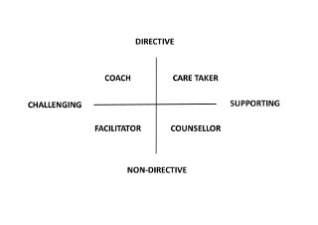
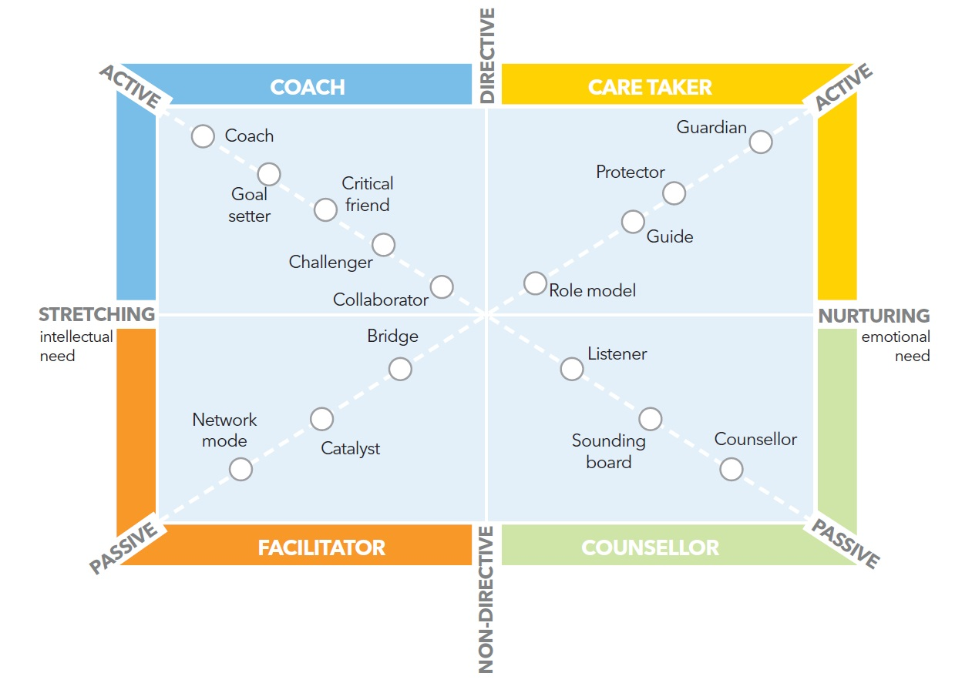
Ways to think about the personal tutoring role
Four styles of helping
Gravells and Wallace (2007)
Gravells and Wallace (2007) adapted from Clutterbuck (1985)
Which areas are you most comfortable with?
What might influence your approach?
Notes:
2 mins (33 mins)

Slide 9
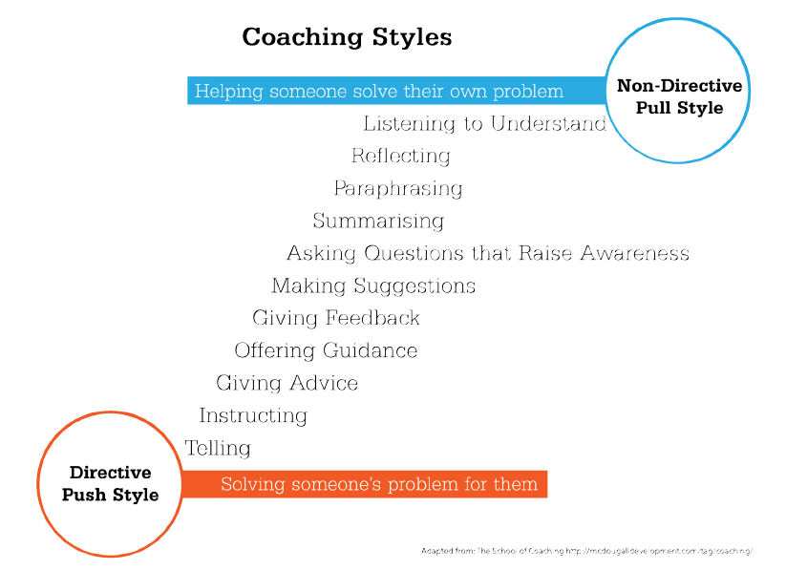
Using Coaching
One definition is: ‘coaching is unlocking a person’s potential to maximise their own performance. It is helping them to learn rather than teaching them’ (Whitmore, 2002).
Notes:
2 mins (35 mins)
Discuss the definition.
Where would you place your practice on this Directive/Non-Directive scale?

Slide 10
Imagine a student has made an appointment to discuss how the move from the 2:1 band to the 1st band…
GROW Coaching Framework
Framework | Question
G – Goal | Where are you now?
R – Reality | What will you do?
O – Options | What do you want?
W – Will | What could you do?
Notes:
2 min (37 mins)
Explain this framework. How might this framework be useful in this scenario? Which questions match to which part of the framework?
Refer to Personal Tutoring Resources on UTA website:
https://www.mmu.ac.uk/about-us/professional-services/uta/teaching/personal-tutoring

Slide 11
GROW Coaching Framework
Framework | Question
G – Goal | What do you want?
R – Reality | Where are you now?
O – Options | What could you do?
W – Will | What will you do?
Notes:
2 mins (39 mins)
Explain and discuss answers. GROW often used successfully for ‘proactive’ Personal Tutoring meetings/conversations.

Slide 12
‘Letting Go’ and Referral – when to do it?
Maintaining confidentiality, when did you most recently think that your own support of a student had been exhausted? How did you know and what did you do?
Notes:
4 mins (43 mins)
Thoughts from those willing to share.
Answers in the chatbox and/or using the mic.

Slide 13
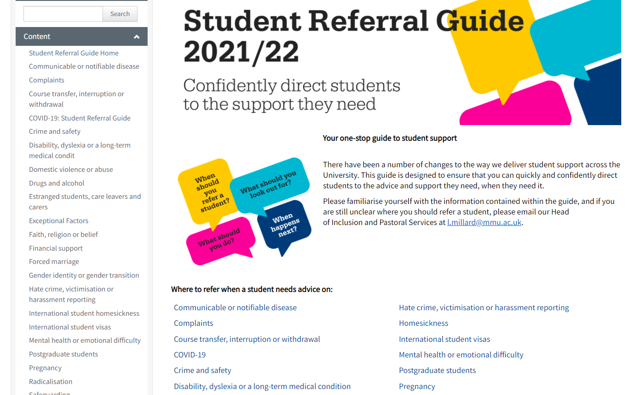
Referral
For specific issues, please use the Student Referral Guide (on the right) or direct tutees to the Student Hub (Business School, Brooks). If you believe there may be a safeguarding issue, advice is available on the Safeguarding intranet page.
When you/the student don’t know what kind of support they need, they can also complete this Wellbeing Support Questionnaire.
Notes:
2 mins (45 mins)
The Student Referral Guide is detailed and worth bookmarking:
https://mmuintranet.mmu.ac.uk/Interact/Pages/Section/Default.aspx?Section=5306&utm_source=interact&utm_medium=quick_search&utm_term=student%20referral%20guide%20mmu

Slide 14
Case Study
A tutee knocks on your door without an appointment and they
are upset…
Notes:
1 min (46 mins)
We will now use BATHE on this case study.
This is an example of a Reactive Meeting (when a crisis occurs) as opposed to a Proactive Meeting, which are timetabled and/or tutor-initiated.

Slide 15
Consider Using ‘BATHE’
Background: What’s going on?
Affect: How’s it affecting you?
Trouble: What’s troubling you most?
Handling: How are you handling it?
Empathy: I can understand this is difficult?
Notes:
10 mins (56 mins)
BATHE is a mnemonic, a memory aid. BATHE often used for ‘reactive’ Personal Tutoring meetings/conversations.

Slide 16
Questions
Dr Eileen Pollard SFHEA
Lecturer in Academic Development, UTA
e.pollard@mmu.ac.uk

Slide 17
Overview of Resources
Personal Tutoring Policy.
Information about Presto.
UTA Personal Tutoring Resources.
Student Referral Guide.
Student Code of Conduct.
Staff Wellbeing Resources.
Effective Personal Tutoring in Higher Education (Lochtie et al, 2018).
UK Advising and Tutoring Association (UKAT).
Notes:
2 mins
The UK Advising and Tutoring Association (UKAT) is the sectoral voice and leading association for personal tutors and academic advisors.
UKAT has several resources to support delivery of personal tutoring, including free resources, webinar recordings and presentation slides from practitioners in universities around the UK and beyond.

