Slide 1
Personal Tutoring Five-Minute Explainer Dr Eileen Pollard
Notes:
Welcome to this Personal Tutoring Five-Minute Explainer. My name is Eileen and I’m the personal tutoring contact in the University Teaching Academy.

Slide 2
Personal Tutoring Policy and My Five Year Plan (My 5YP)
… a student support system, delivered by academic staff through a coaching approach that recognises the importance of personalised and individual support in creating equal opportunities for students to succeed […] and fulfil their potential through a five-year planning approach to personal, academic and career development.
Notes:
The current Personal Tutoring Policy was developed following a HEFCE funded research project on personal tutoring at Manchester Met conducted by colleagues in UTA (Prowse et al, 2021).
My Five Year Plan (My 5YP) can be delivered via Personal Tutoring and/or through units.
This, and other slides, are hyperlinked.

Slide 3
‘Proactive’ use ‘GROW’
Goal: What do you want to achieve?
Reality: Where are you now?
Options: What could you do?
Will: What will you do?
Notes:
This is GROW model often used successfully for ‘proactive’ Personal Tutoring meetings/conversations, which are initiated by students.

Slide 4
‘Reactive’ use ‘BATHE’
Background: What’s going on?
Affect: How’s it affecting you?
Trouble: What’s troubling you most?
Handling: How are you handling it?
Empathy: I can understand this is difficult?
Notes:
Like GROW, BATHE is a mnemonic, a memory aid. BATHE often used for ‘reactive’ Personal Tutoring meetings/conversations, which are initiated by the tutor.

Slide 5
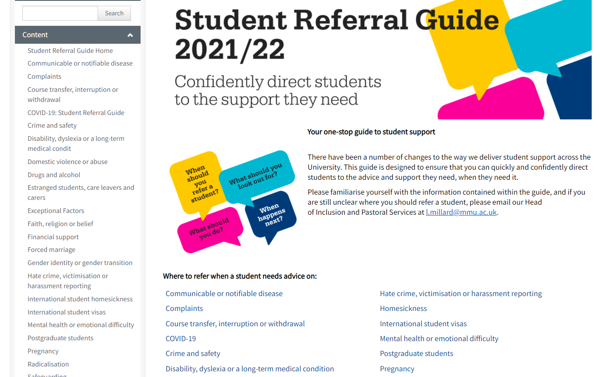
Referral
For specific issues, please use the Student Referral Guide (on the right) or direct tutees to the Student Hub (Business School, Brooks). If you believe there may be a safeguarding issue, advice is available on the Safeguarding intranet page.
When you/the student don’t know what kind of support they need, they can also complete this Wellbeing Support Questionnaire.
Notes:
The Student Referral Guide is detailed and worth bookmarking along with the safeguarding intranet page.

Slide 6
Overview of Resources
Personal Tutoring Policy.
Information about Presto.
UTA Personal Tutoring Resources.
Student Referral Guide.
Student Code of Conduct.
Staff Wellbeing Resources.
Effective Personal Tutoring in Higher Education (Lochtie et al, 2018).
UK Advising and Tutoring Association (UKAT).
Notes:
This is an overview of key resources, including resources to support staff wellbeing.

