Slide 1
Exchanging transnational design values in fashion pedagogy through collaborative online learning projects (coil)
Rebecca Neary, Dr Patsy Perry, Kat Scott, Elizabeth Kealy-Morris
Manchester Fashion Institute
Faculty of Arts and Humanities
Manchester Metropolitan University
LEED Conference
Manchester Metropolitan University, 14th June 2023
Notes:
1. BEIJING INSTITUTE FASHION TECHNOLOGY, CHINA
2. ROYAL MELBOURNE INSTITUTE OF TECHNOLOGY, AUSTRALIA
3. REBEL TARTAN & a new silk road, WUHAN, CHINA
4. fashion in motion PEARL ACADEMY, INDIA
5. FASHION PROMOTION, PEARL ACADEMY, INDIA
6 'DIGITAL FASHION ANIMATION ' PEARL ACADEMY, INDIA
Exchanging transnational design values in fashion pedagogy through Collaborative Online International Learning projects (COIL)

Slide 2
Notes:
1. BEIJING INSTITUTE FASHION TECHNOLOGY, CHINA
2. ROYAL MELBOURNE INSTITUTE OF TECHNOLOGY, AUSTRALIA
3. REBEL TARTAN & a new silk road, WUHAN, CHINA
4. fashion in motion PEARL ACADEMY, INDIA
5. FASHION PROMOTION, PEARL ACADEMY, INDIA
6 'DIGITAL FASHION ANIMATION ' PEARL ACADEMY, INDIA

Slide 3
Collaborative online international learning (COIL)
Pedagogical approach to facilitate development of intercultural competences and digital skills via meaningful online collaborations between students and tutors in geographically distant locations (de Wit, 2013)
Flexible, versatile and inclusive approach to the provision of international student experience opportunities (Villar-Onrubia & Brinder Rajpal, 2016)
Collaborating with peers in another country/culture prepares students for the future of work, supporting skills development in intercultural communication and teamwork alongside context-specific subject learning
Opens up plurality of knowledges and supports epistemic justice – challenging Western hegemony of education and Euro-centric design thinking

Slide 4
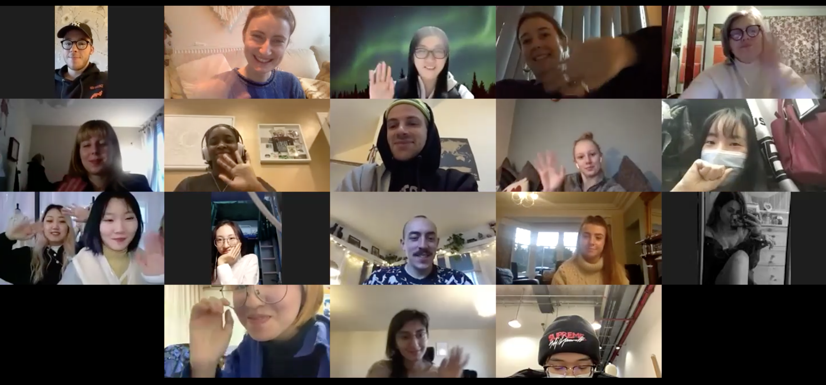
LEARNING THROUGH Collaboration
All projects were developed to include:
Clear student-centred collaborative learning strategies
Relevant to their study and future careers
Multicultural
Actively experiential to encourage dialogue between peers, tutors, and clients
Active development of rich real-world expertise
Above: Craftisan Project in 2021 with Pearl Academy, India – Project Pitch Call
Right: Fashion Impact in 2020 with Beijing Institute of Fashion Technology, China – Presentation Call
Notes:
Rooted in social learning theory, a key premise of collaborative learning is that we develop an understanding of our experiences through frameworks of language and culture in relationships among individuals (Alice Udvari-Solner 2012: 632).
In this way, collaborative learning offers opportunities to learn alongside peers who may possess more knowledge in some areas with conceptual development taking place via activities requiring challenges of modeling, critical evaluation, and reasoning.
These projects can be really challenging, but as the design outcome of this collaboration demonstrate, they can often lead to ambitious results that take students one step closer to ‘global career ready'.
The image here is a screen grab from an online pitch session between artisans, students and educators lead by a group of Pearl Academy and Manchester Metropolitan University students and delivered to artisans who students were collaborating with on The Craftisan Project during the pandemic in 2021.

Slide 5
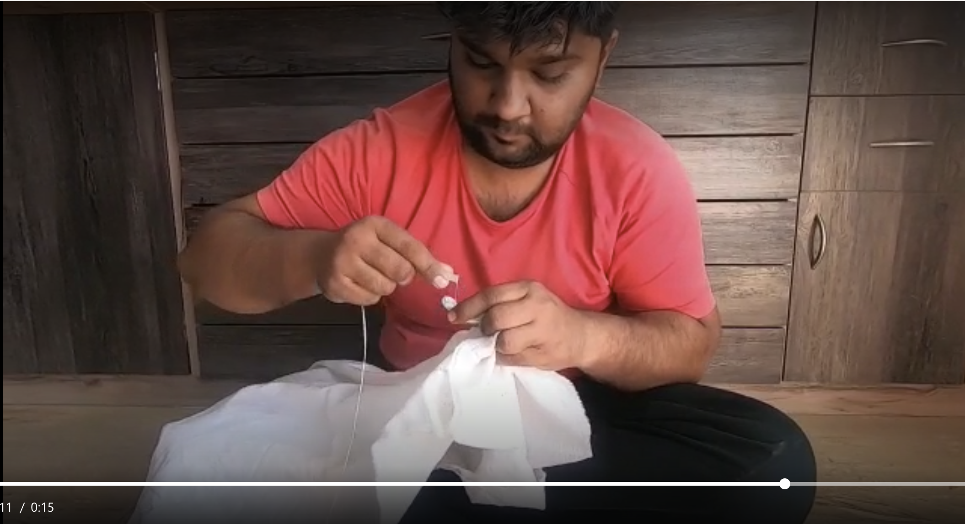
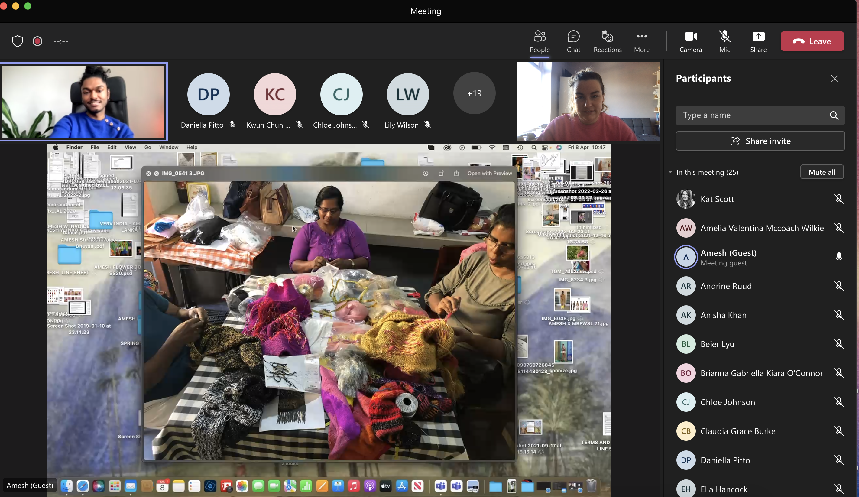
Working towards Decolonising The curriculum
Creating inclusive and reciprocal pedagogy is an opportunity to foster cultural appreciation via empathy and human connection
Allows students to create a new value system where skills and roles in the fashion industry are dissolved and an open discussion on lived experiences and different cultural perspectives becomes the focus
Helps to map the real-world and human context of the fashion industry and the people that are involved in every stage and specialism, developing emotional intelligence with future fashion practitioners
Adil Bhai demonstrating his artisan skills in bandhani dyeing to students during the Craftisan Project with Pearl Academy, India, May 2021
Sri Lankan designer Amesh Wijesekera Masterclass with artisans during Unit X project with Wuhan Textile University, China, May 2022
Notes:
The projects discussed here were designed with important collaborative learning experiences which engaged students in fellowship and teamwork across the international divide. education that includes collaboration and communication leads to empathy and understanding.
Role reversal – perceptions of value, cultural appreciation and empathy.
Freire (2017: 45) notes, “Knowledge emerges only through … the restless, impatient, continuing, hopeful inquiry human beings pursue in the world, with the world, and with each other .” He continues by noting that dialogue and communication are essential to critical thinking which in turn sparks learning. He highlights that without communication there is no learning. Learning, therefore, is a social activity.
But how might we support our students to develop the social skill of empathy with other cultures that is so key to international fashion careers? J. David Carlson and Terry Dobson (2020: 430) suggest, “inclusive art and design pedagogy can foster collaborative learner-centred approaches to develop empathy as a key component of emotional intelligence.” The projects discussed here were designed with important collaborative learning experiences which engaged students and artisans together in fellowship and teamwork across the international divide.

Slide 6
COIL Project STRUCTURE / framework
OPEN BRIEF – GLOBAL TOPICS
Icebreaker
Visual & verbal
MASTERCLASSES, TECHNOLOGICAL EXCHANGE, & SELF-DIRECTED COLLABORATION
Presentation & reflection
Celebration & exposure
TESTING & REALISATION
Notes:
Generic broad framework but specifics would evolve organically for each project
1. Co-creating project brief with partner. Equitable partnerships. Learning outcomes should incorporate the development of global perspectives and/or fostering intercultural competences for global citizenship.
2. Icebreaker example – Pearl slow media slow fashion -
Record and share a 30-second video to introduce yourself. Tell us in three shots:
A little about you (incl. name and course of study)
The place you live
A recommendation of a great story that drew you in (can include any of (online/print article, video, podcast, etc)
When you post the video, also write what you would like to produce as part of this project: audio, video, words, photography, graphics.
3. Maintaining student engagement online – regular tutorials to check in, for accountability. Careful choice of masterclasses to be relevant and inspiring, esp when online. Plugging skills gaps, sharing resources.
4. Production
5. Reflection – on a group call. Reflection on each masterclass.
6. Synchronous and asynchronous presentations of outcomes to take account of time differences.
7.

Slide 7
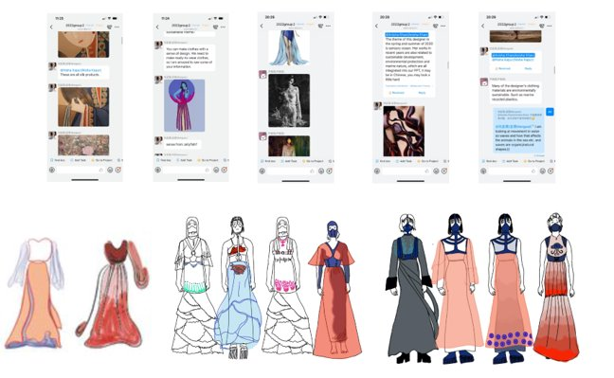
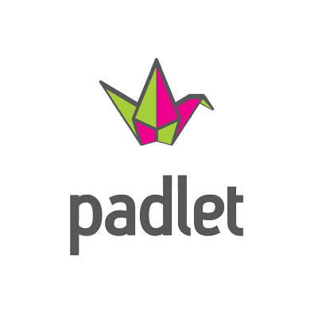
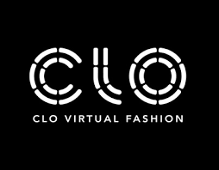
virtual collaboration TECHNOLOGIES
Digital platforms we all interact with offer everyday insights into multi-faceted cultural values, and the everyday evolution of ideas and design contexts
Creating pedagogy that uses EdTech and Social Media to develop inter-cultural understanding and communication are a direct reflection of our global society
Dingtalk exchange and collaboration - A New Silk Road - BA (Hons) Fashion x Wuhan Textiles University
Notes:
We have found that all students are adept to in using virtual collaborative technologies. This understanding is an immediate exchange tool for students on different time zones and they communicate using different interfaces with ease – they are an extension of what they already use within their daily life. This has been consistent with partners spanning different continents and is a direct reflection of our collective global society.

Slide 8
navigating language barriers with digital technologies
Hybrid digital and physical practices can push the boundaries of creative fashion practice and demonstrate how digital technologies allow students to overcome language barriers and communicate through asynchronous and synchronous digital fashion production, creating a digital studio culture
”To accurately visualise someone's design idea needs really good knowledge but CLO-3D makes this exchange more interesting. I started to work with Li and asked her to make her design idea more clear, to add descriptive details.”
Natalija’s Reflections
Natalija X Li, MFI collaboration with Beijing Institute of Fashion Technology
Notes:
Neither Natalija nor Li Yu had English as their first language throughout this process in the video. Not only that they had different timezones as a challenge. Natalija digitally prototyped Li Yu's work via sketches and conversations via WeChat. This enabled them both to experiment with digital production techniques and how to communicate with visuals and technology only.

Slide 9
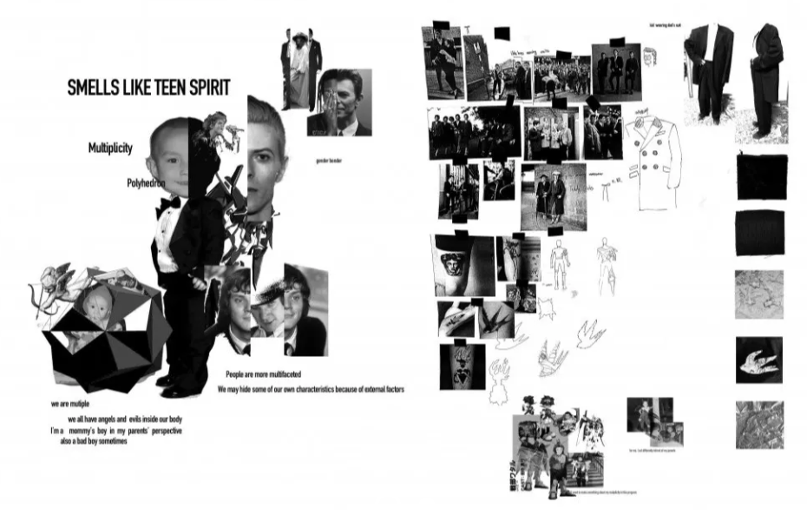
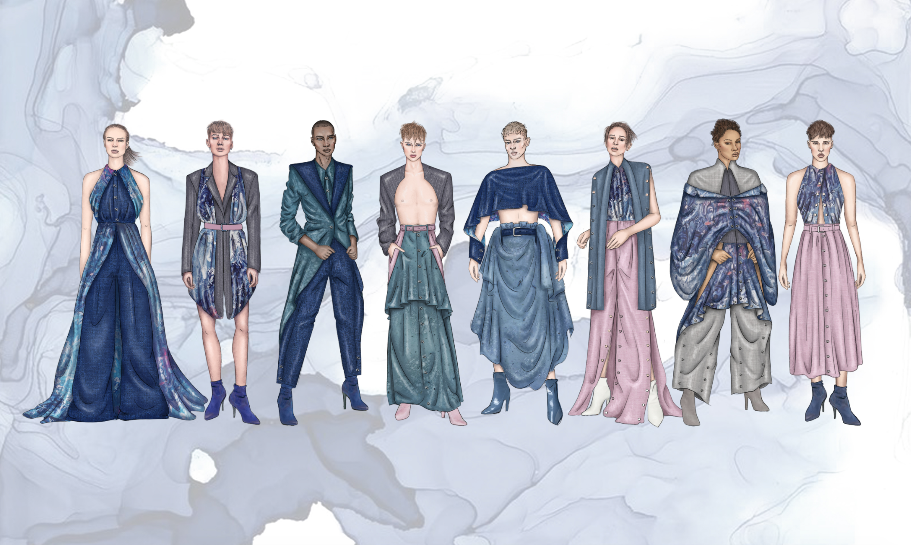
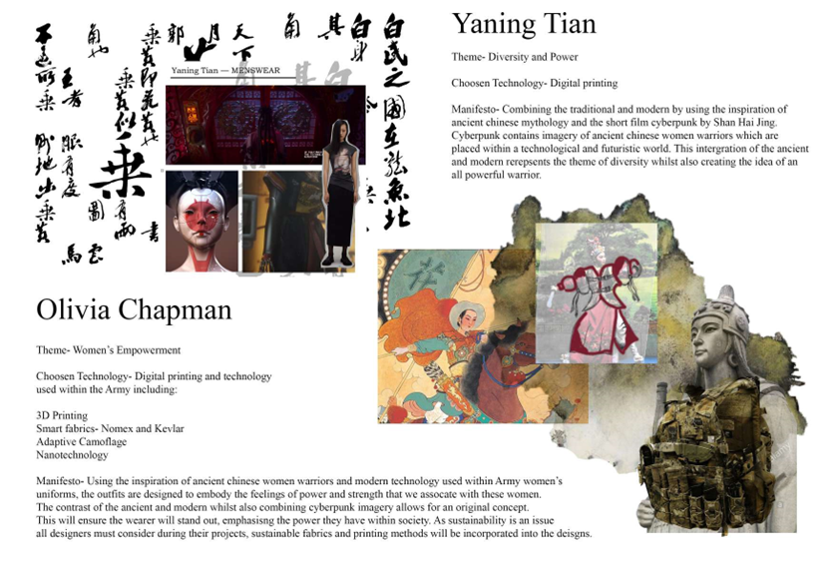
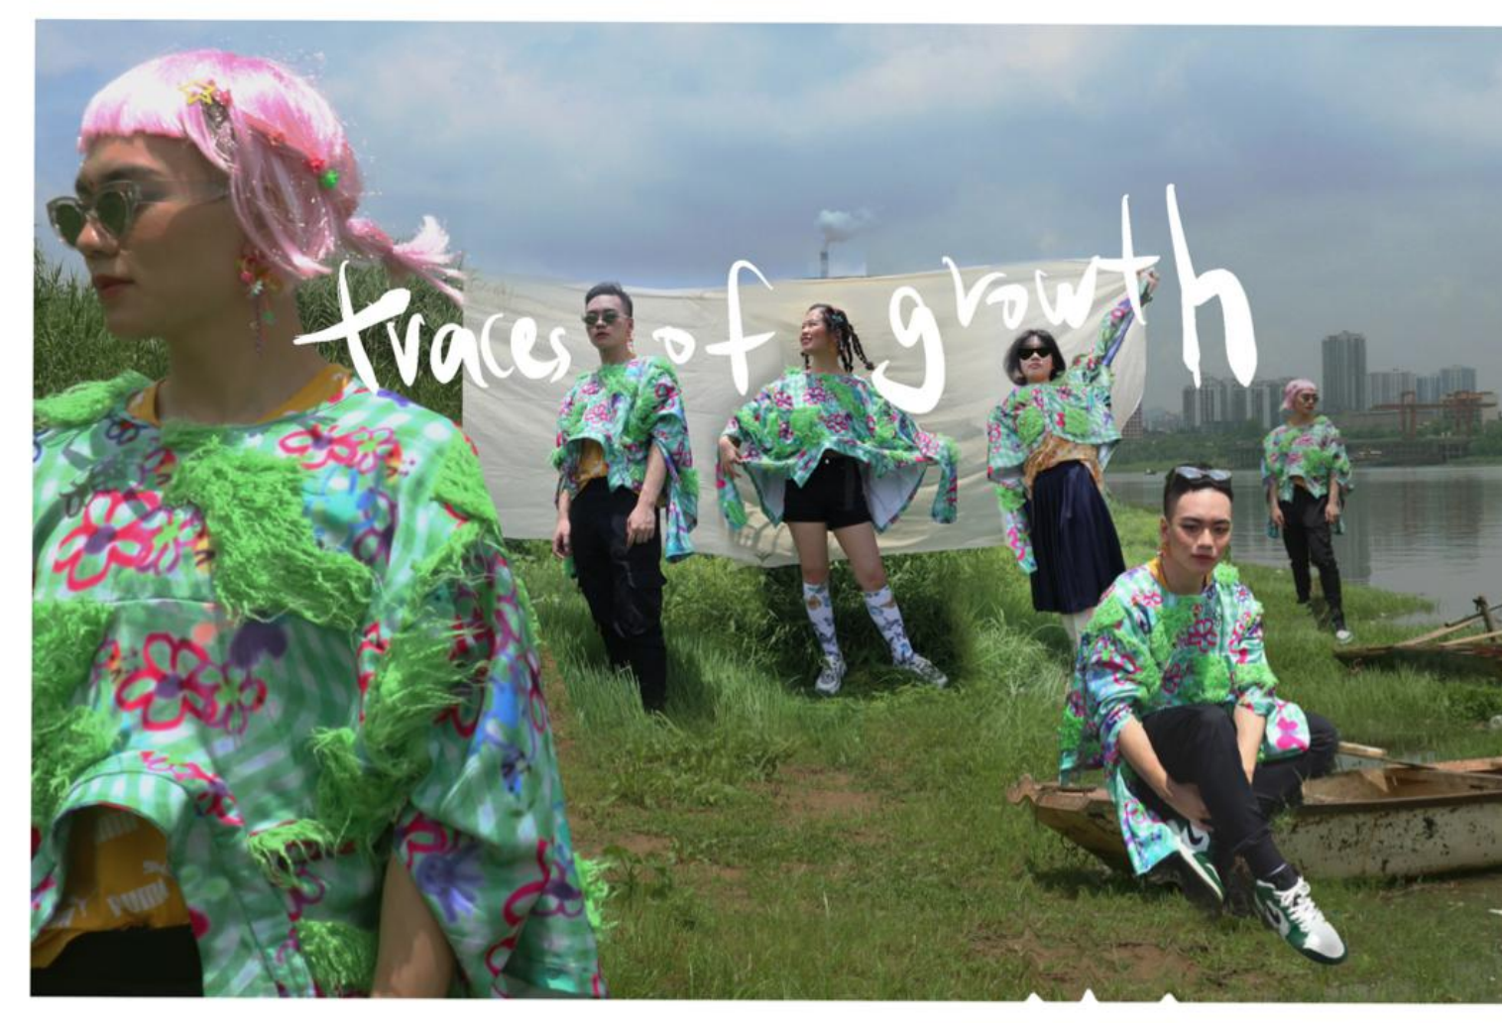
FASHION IMPACT - BEIJING INSTITUTE OF FASHION TECHNOLOGY
Open brief incorporating Sustainability, Innovation, Inclusivity & Diversity
Notes:
19/20 & 20/21
Themes included: Sustainability, Innovation, Inclusivity & Diversity
Project Lasted Between 4 & 6 weeks
2 months of collaboration with the BIFT teaching team to get all the details and timings in place.
First Year of the Project: 22 students / Second Year of the Project: 15 students from both institutions.
Students were paired up 1on1 via design proposal submission (icebreaker activity)
Outcomes: Beijing Exhib, Digital Exhib, Fashion Film, Manchester Exhib, Publication

Slide 10
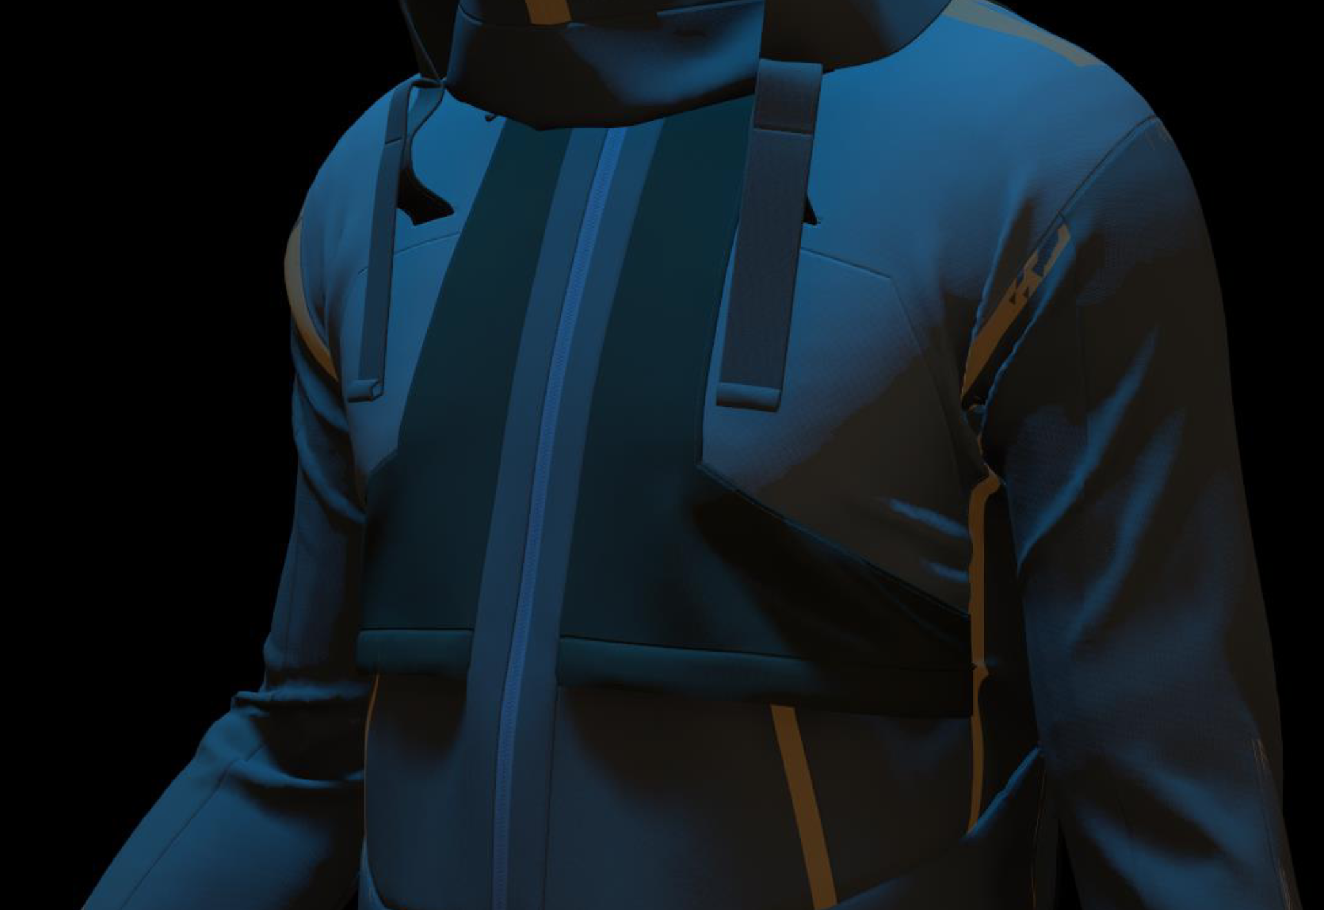
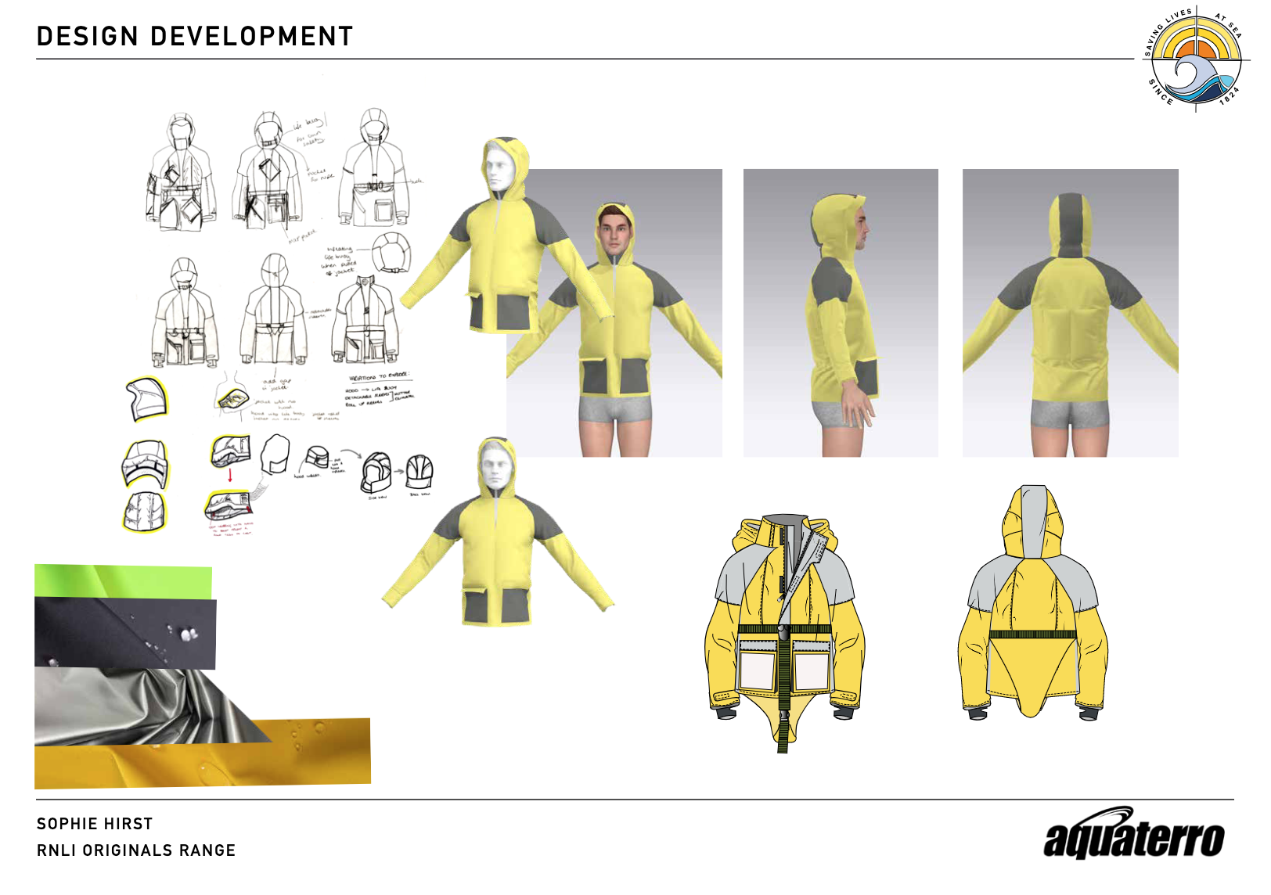
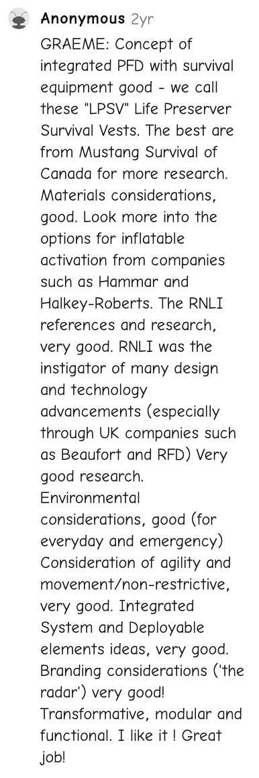
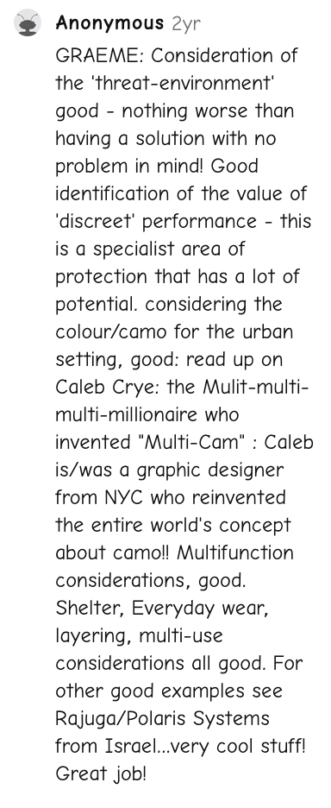
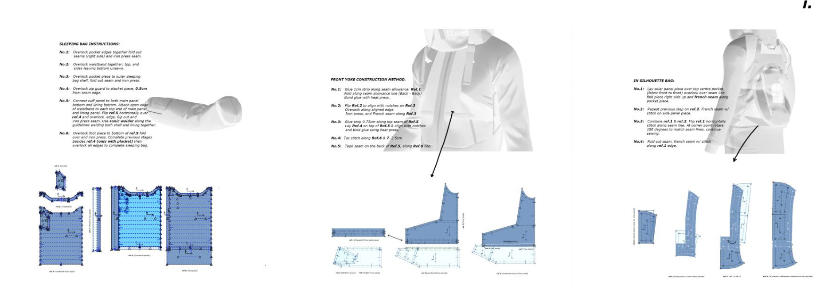
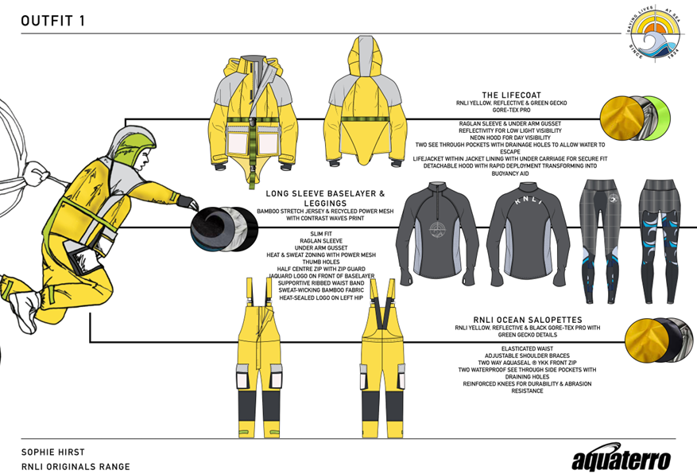
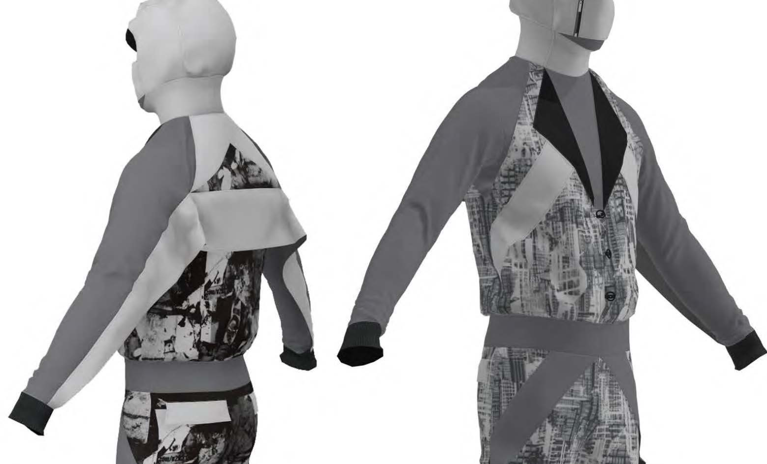
ROYAL MELBOURNE INSTITUTE OF TECHNOLOGY (RMIT) & AQUATERRO
Survival Project with Aquaterro (industry partner based in Australia)
Notes:
Themes- Innovation, Technology, Modular, Transferable, Multi use, Survival, Protection
Timeline- 10 weeks approx
Planning Timeline- 6 weeks approx
Group size- 11 RMIT & 11 MMU =22
Collab size- 1 on 1 pairs up to individual piece of work submitted- students were able to collaborate as much or as little once the collab design proposal was reviewed.
Outcomes- Artefacts and 3D Digital outcomes, Industry competition critique and certificate of recognition/ merit from Aquaterro.

Slide 11
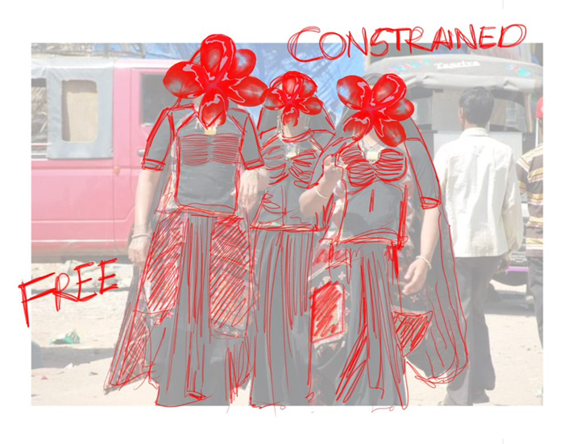
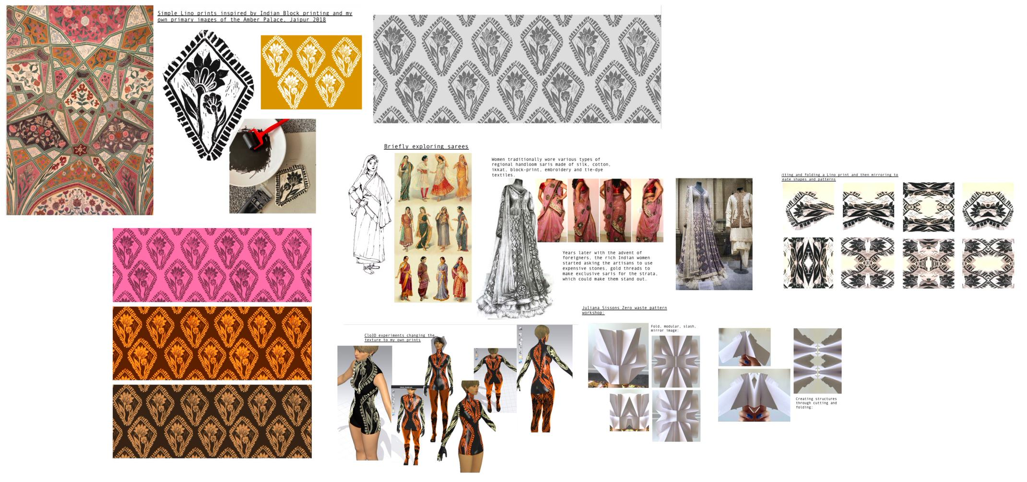
Fashion in motion - pearl academy
Design for movement, through the lens of dance genres from India and UK
Fashion in Motion Project 2021 and 2022: Manchester Fashion Institute x Pearl Academy Digital Sketchbook Work
Notes:
Design for movement, through the lens of dance
Juxtaposing dance genres from India and UK, modern and traditional
Micromovements of hands in dancing and how that translates into design
Block print inspired from palace in Jaipur- home-made block print- utilised in CLO3D
Themes-
Timeline- 6-8 weeks
Planning Timeline- 10 weeks approx
Group size- 20
Collab size-

Slide 12
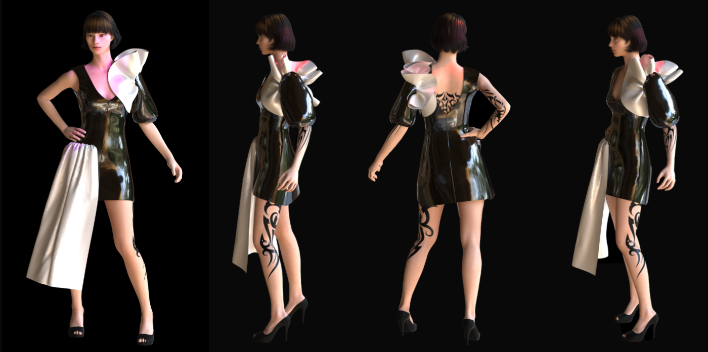
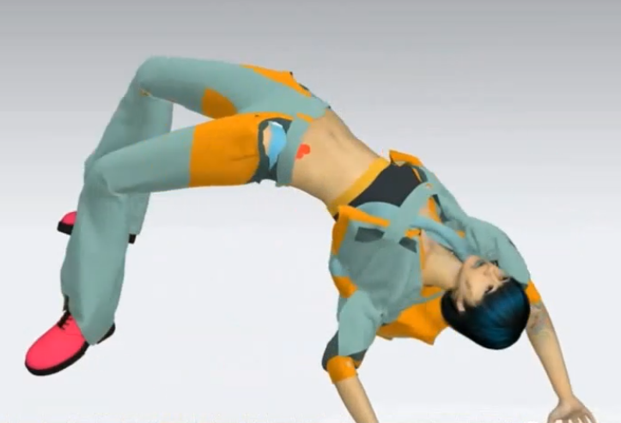
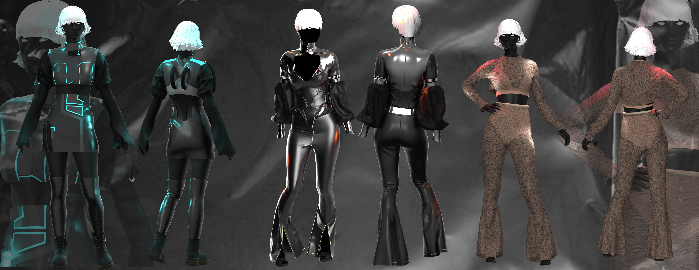
DIGITAL FASHION ANIMATION – PEARL ACADEMY
Development of ethnicity specific avatars and virtual fashion collections using CLO3D and Premiere Pro​
Digital Fashion Animation Project 2022: Manchester Fashion Institute x Pearl Academy outcomes
Notes:
The project was run in block 4 (25 April – 3 June 2022). Capture dynamic video clips with virtual fashion prototypes. Generate professional standard digital content for fashion promotion
As some of MFI L5 students already participated international projects in the previous block and some were looking for placements, only 1 MFI student participated with 10 from Pearl Academy. The MFI student assisted in online delivery of master classes on virtual clothing prototyping by MFU tutor. Pearl tutor delivered masterclass on video editing. Each participant submitted individual work on fashion animation. (Run the video from mmutube link provided on slide) https://mmutube.mmu.ac.uk/media/Fashion+Animation+-+RISE+2022/1_pgupi8ki

Slide 13
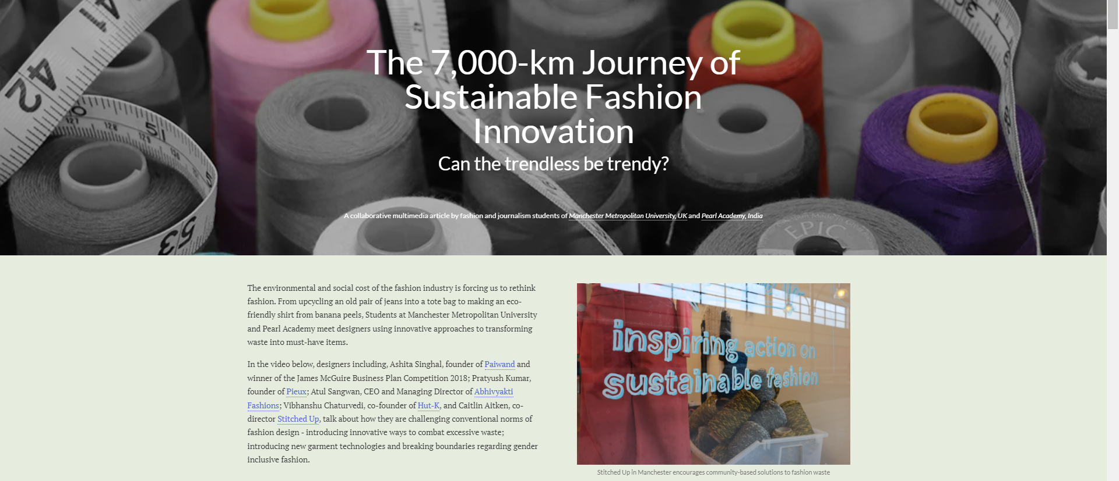
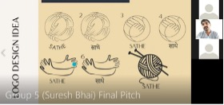
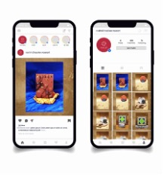
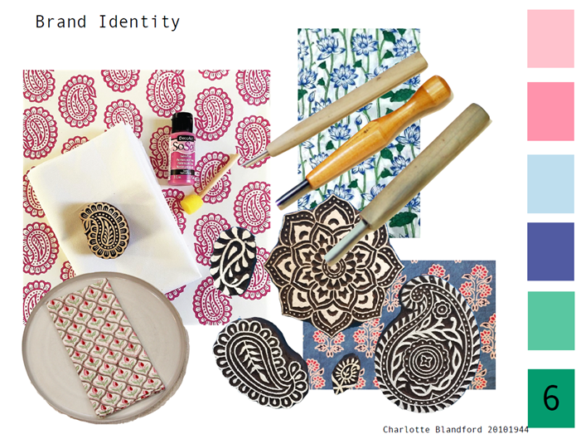
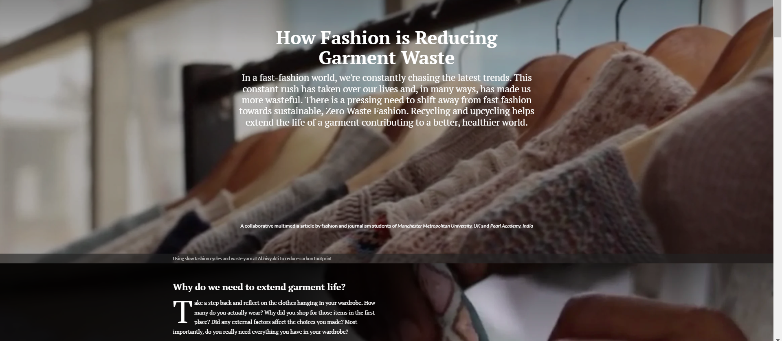
FASHION Communication – PEARL ACADEMY
Creating multimedia longform stories on slow fashion and brand books for Indian artisans
CRAFTISAN / GLOBAL ARTISAN PROJECT
SLOW FASHION, SLOW MEDIA – longform multimedia outputs resulted from a cross-disciplinary project for Fashion Promotion, Fashion Art Direction and Multimedia Journalism students
Craftisan Project 2021 : Pitching brand logo variations for artisan designer Suresh Vankar
Global Artisan Project 2022: App mockup for artisan designer Roshni Thacker’s brand Rose Art
Global Artisan Project 2023: Development of branding assets for block printer Vankar Jepar as coursework for L4 Visual Communication

Slide 14
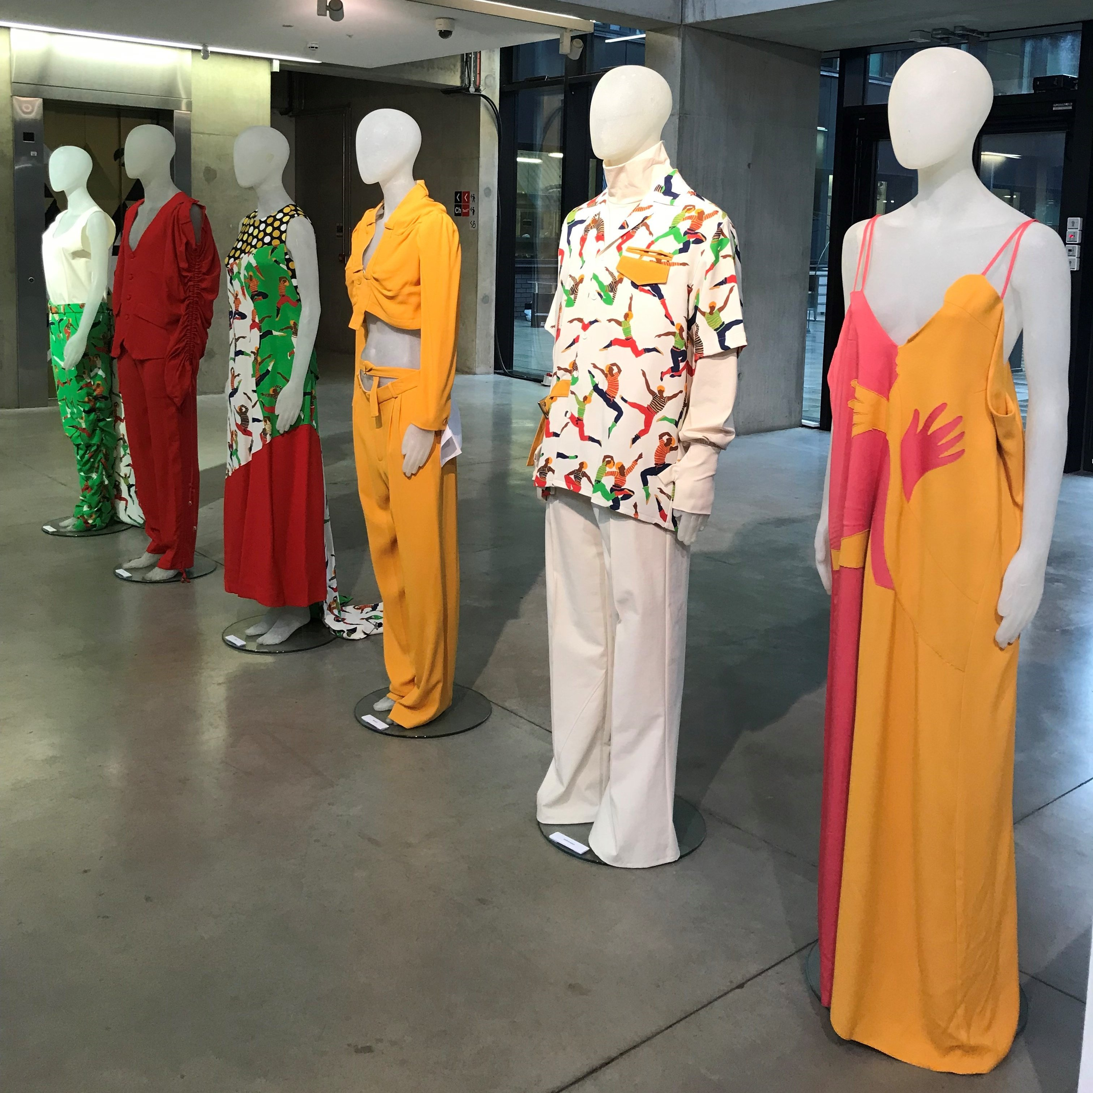
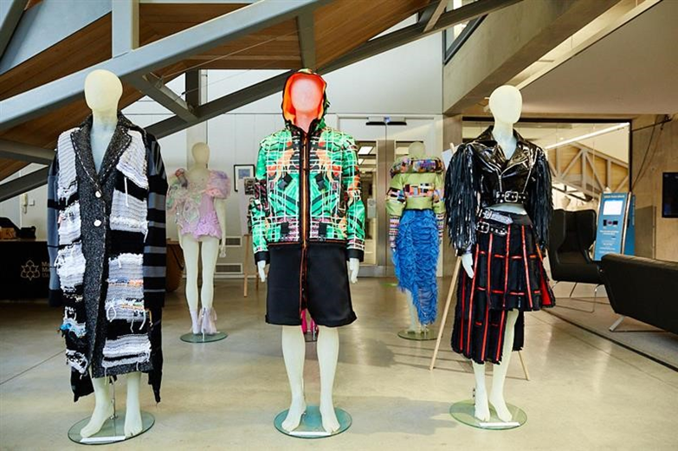
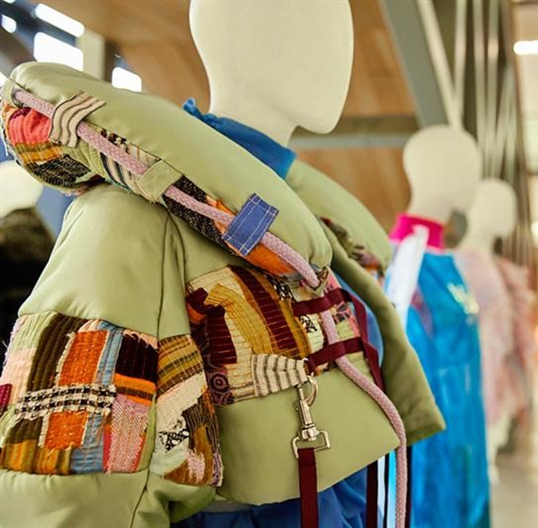
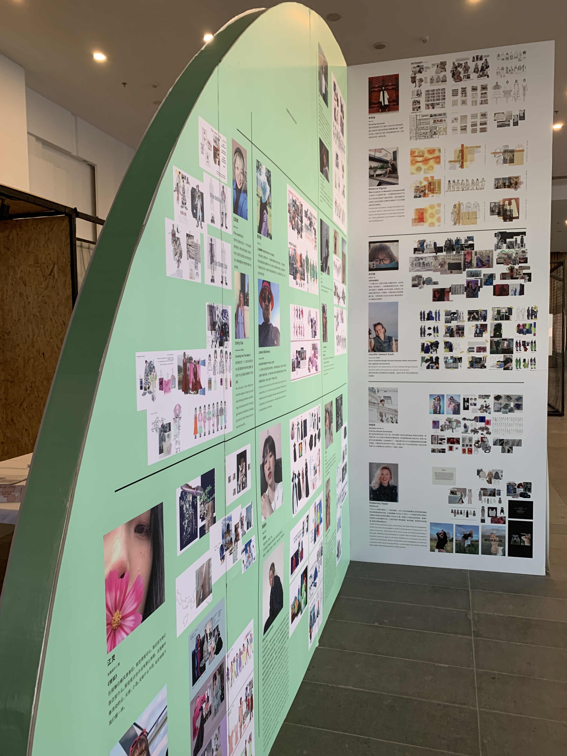
Celebration and Exposure of outcomes
Fashion Film, Runway Show, Static Show, Physical & Digital Exhibition, Academic & Media Publication
Regional & International Impact
Notes:
https://www.youtube.com/watch?v=v625VQvdP7E&t=54s
https://youtu.be/bAv324xYl4g
outputs range from design/trend concepts and physical outfits to promotional campaign materials and multimedia journalism

Slide 15
Reflections
PLUS
Intercultural communication and understanding developed Developing multi-cultural design values, that are embedded in the students' learning journey Partnerships and connections formed across cultures and institutions Increased attainment levels (e.g. 12% overall) Increased student self-efficacy, meta-cognition and intrinsic motivation Global career-ready skills developed Exciting projects to teach and lead, rewarding for staff involved. Student feedback has been really positive.
minus
Technological inclusivity is a limitation for participants who cannot gain access to software or internet Technological issues, such as CLO3D licenses. Engagement - not all students engage for the entire project; but the short timeframe for projects can be challenging for students to fully engage in this time Can be a time-consuming endeavor with many fine details to iron out between teaching teams who are still getting to know each other
interesting
1-on-1 student pairings can increase accountability and engagement Every project has its own organic structure Celebrating student outcomes helps to develop the project further Mentor groups works well to support the collaborative groups to work through technical and communication hitches. Timeframe element needs to be experimented with Pros and cons of embedding within curriculum vs. extra-curricular Keep it simple! Don't underestimate the time needed to cocreate and plan the project with the partner
P.M.I. Method by Dr Edward De Bono

Slide 16
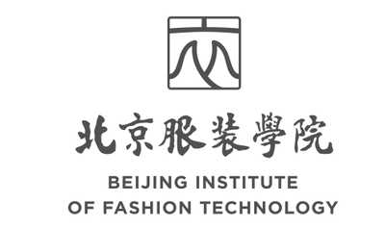
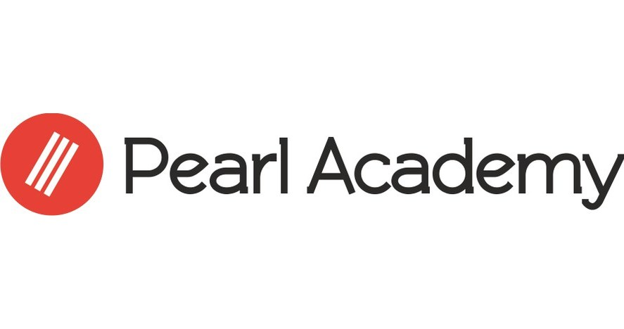
Thank you!
Acknowledgements
Manchester Fashion Institute Academic and Technical Staff
Faculty at Beijing Institute of Fashion Technology, China
Faculty at Royal Melbourne Institute of Technology, Australia
Faculty at Wuhan Textile University, China
Faculty at Pearl Academy, India

