Slide 1
Internationalisation of the Curriculum in Action Collaborative Online International/Intercultural Learning (COIL) Manchester Metropolitan University (MMU)
Notes:
This is first about internationalising the curriculum and the teaching and learning experience through experiential learning with peers who are ‘cultural others’. So the primary focus in terms of development is the acquisition of intercultural competences.
Also called VE, telecollaboration, virtual mobility, etc - At the heart of it is the acquisition of intercultural competences for both students and academics through peer-to-peer engagement.
There are different models of COIL as we will see. The one I am presenting here was developed at Coventry University in the 2010s and nowadays it benefits between 7,000 and 8,000 students a year with over 200 projects across all faculties.
With such large participation, CU has become the largest COIL institution in the world (see www.COILconnect.org) with 170 projects in 2020-21 (the second Universidad LaSalle Mexico has 88 projects).

Slide 2
Training Workshops July 12th 2022 Aims of the Intro Session
Aim 1: To gain a better understanding of how Inter-Cultural Competence (ICC) can be defined, and what its key tenets are, and how ICC can be organically acquired.
Aim 2: To be able to articulate some of the rationales for embedding ICC in HE curricula and the multilevel benefits for key stakeholders.
Aim 3: To gain a critical understanding of what the COIL framework is, its pre-requisites and different models/types for internationalising the curriculum.
Aim 4: To identify important institutional conditions and academic development stages for COIL to be fostered successfully in HEIs, drawing on lessons learnt and pitfalls (and examples from practice)
Aim 5: To explore a possible approach for developing and delivering a Third Space COIL program that includes understanding and respecting cultural similarities and differences in cross-cultural patterns of communication and collaboration, and addresses differentiated linguistic and digital literacies

Slide 3
Intercultural Competence (ICC)
The ability to communicate and operate appropriately and effectively in multicultural contexts and teams, drawing on one’s intercultural knowledge, attitudes and skills. Adapted from Deardorff, D. 2004; emphases added.
A set of cognitive, affective, and behavioural skills and characteristics that support effective and appropriate interaction in a variety of cultural contexts. Bennett, J.M. 2008; emphases added.
Knowledge is about raising intercultural awareness beyond stereotypes, biases and prejudices, understanding both oneself and one’s own and others’ mindsets, ways of feeling, thinking, and doing. It is about values, norms, practices, facts, frameworks, etc. (Cognitive).
Attitudes are about understanding and fostering values of curiosity, inclusivity, tolerance, empathy, etc (Affective); this will trigger different behaviours and ultimately more agility/skills in managing diversity for better efficiency and effectiveness. (Skills)
ICC [is] […] a state of becoming rather than a destination (Leask, 2015)
Experience is about the organic/developmental character of learning by doing (DMIS, Bennett, 1984); competences are developed across time and a series of diverse experiences, including dialogue, encounters, teamwork, mobility, but also mistakes, misunderstandings, cultural incidents, dilemmas (Trompenaars, 2012). Then follow stages of reflection, conceptualization, and experimentation (Kolb, 1984).
Notes:
Knowledge and Behaviour -‘Si fueris Romae, Romano vivito more; si fueris alibi, vivito sicut ibi’, Ambroise of Milan to St Augustin in the 4th century. If you are in Rome, live like the Romans; if you are elsewhere, live as the [local] people do.
But this is not about privileging one system of values over another but to create a point of convergence between two systems where a key premiss is mutual respect and equality.
Here we are looking at a ‘third space’ to identify how to accommodate different forms of cultural habits, values, attitudes and behaviours.

Slide 4
Intercultural Competence (ICC)
Deardorff (2011) identifies 7 fundamental intercultural skills:
Self-awareness/identity (understanding the lens through which we each view the world); ‘Know thyself’
Seeing from other perspectives/world views (both how these perspectives are similar and different); (Zachary, 2000, ‘[…] roots and wings’)
Listening (engaging in authentic intercultural dialogue);
Adaptation (being able to shift temporarily into another perspective);
Relationship building (forging lasting cross-cultural personal bonds);
Cultural humility (combines respect with self-awareness))
Reference:
Deardorff , D.K. (2011). Promoting understanding and development of intercultural dialogue and peace: A comparative analysis and global perspective of regional studies on intercultural competence. Report of the State of the Arts and Perspectives on Intercultural Competences and Skills, UNESCO.
See also: Deardorff, D.K., (Ed.) (2009). The SAGE handbook of intercultural competence. Thousand Oaks: Sage.
Zachary, G. Pascal (2000). The global me; why nations will succeed or fail in the next generation. Sydney, Australia: Allen and Unwin

Slide 5
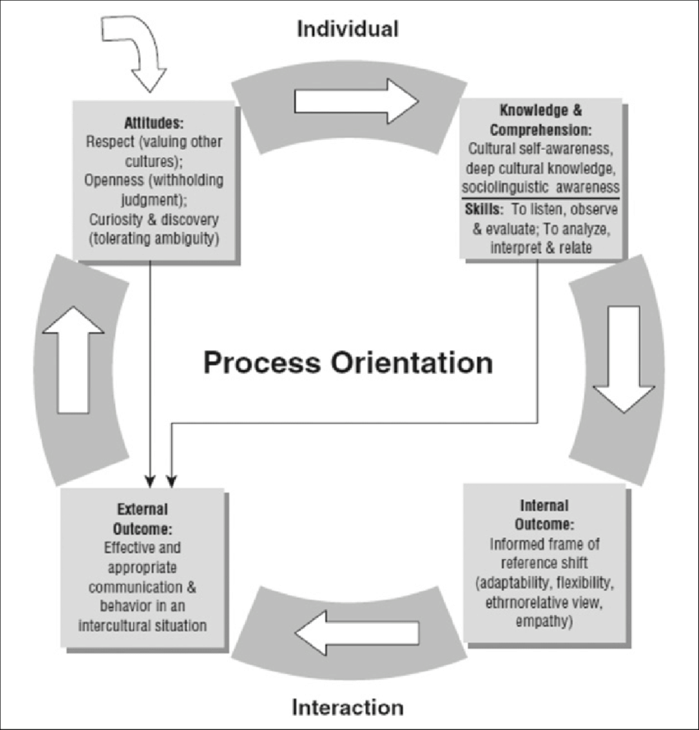
Process Model of Intercultural Competence (ICC) Deardorff 2006 and 2009
Notes:
The acquisition of ICC is a cyclical process: the more you know about others and yourself, the more aware you are about appropriate and effective modes of interacting and your worldviews (internal outcomes) can shift and your behaviour then typically changes too (external outcome). Your attitudes then become more respectful as a result of more successful encounters, and so on.

Slide 6
Rationales
Global Interconnectedness and Widening Participation - Relative lack of understanding of non-Western cultures’ world views (and only about 3% of students benefit from outbound study mobility) for lack of engaging cultural ‘others’ (Jones, 2019)
Diversity management requires ICC skillsets - ICC boosts Effectiveness, Innovation, Creativity and Value Growth (BCG, 2021), and ultimately Employability
Diversity management is needed at universities and in the workplace
To Progress towards Global Citizenship and Common Values
Inclusivity - Students increasingly want diverse experiences and a more inclusive ethos (cultural, ethnic, gender, environmental, etc) in their personal, social and professional lives
COIL is a platform to foster self-perception, respect for others and adaptation (DMIS, Bennett)
Virtual Mobility as Social Responsibility to reduce carbon footprint (UNESCO, Futures of HE, 2022) and Engagement towards Sustainable Development Goals (SDGs)
Digital literacy for all – greatly enhanced since the Covid crisis started, needs to be nurtured and stay abreast with changes and tools (Digital Native fallacy)
Institutions can internationalise their curricula and foster ICC, and develop new and/or deeper institutional partnerships at various levels through COIL with a variety of stakeholders (e.g. leading to study abroad both ways, Top-up articulations, TNE, joint research, etc)
Step towards more balanced and more inclusive joint curriculum designs

Slide 7
What Kind of COIL? Definition, Requisites, and Models/Types
Collaboration with a ‘cultural other’ within a discipline, at a given level, on a given theme/topic/issue/research orientation
Direct collaboration between groups of students (delivery modes agreed by faculty) via social media and online tools
Reflection on and analysis/assessment of cross-/inter-cultural/-national learning, focusing on:
Discipline-specific Knowledge and Practices, Facts and Frameworks and their underlying Rationales/Worldviews or Values across cultural contexts and/or
Intercultural communication and teamwork, and/or
Joint, Cross-Cultural Research Project or Consultancy, and/or
Pedagogical differences and similarities and/or
Differences in access to, and confidence and proficiency in, using digital channels and toolkits in English
Specific Internationalised Learning Outcomes, Activities and Assessments (Constructive Alignment approach)

Slide 8
Collaboration with a non-UK partner within a discipline, at a given level, on a given theme/topic/issue/research orientation
Direct interaction between groups of students (delivery modes agreed by faculty) via social media and online tools
Reflection on and analysis/assessment of cross-/inter-cultural/-national learning, focusing on:
Discipline-specific Knowledge and Practices, Facts and Frameworks and their underlying Rationales/Values (see Compared Fiscal Policy UK/ Uganda), and/or
Intercultural communication and teamwork, and/or
Joint Research Project or Consultancy, and/or
Pedagogical differences and similarities, and/or
Differences in access to, and confidence and proficiency in using digital channels and toolkits in English
Specific Intercultural Learning Outcomes, Activities and Assessments (Constructive alignment approach)
What Kind of COIL? Definition, Requisites, and Models/Types

Slide 9
Compared Fiscal Policy (the UK and Uganda) http://onlineinternationallearning.org/projects/
PROJECT OVERVIEW
This was an opportunity for students at Makerere University, Uganda and Coventry University, UK to identify an area of fiscal or monetary policy where they can compare the actions taken by the respective countries.
The joint teams prepare a group report on the subject matter alongside a digital output reflecting on the experience and intercultural collaboration.
OIL OUTCOMES
1. To develop collaborative skills using synchronous and asynchronous tools. 2. To work to tight deadlines to produce two outputs. 3. To develop an understanding of intercultural differences and working practices.
TYPE OF INTERACTION
Collaborative document building, critical reflection and social media interactions.
OIL OUTPUTS
Each group to collaboratively prepare a report of approx. 3,000 words.
Each group to produce a short document (e.g. blog, video) in which it reflects on the experience of working/collaborating within an international context),
a reflective statement of no more than two pages.

Slide 10
Compared Fiscal Policy (the UK and Uganda) http://onlineinternationallearning.org/projects/
PROJECT OVERVIEW
This was an opportunity for students at Makerere University, Uganda and Coventry University, UK to identify an area of fiscal or monetary policy where they can compare the actions taken by the respective countries.
The joint teams prepare 1. a group report on the subject matter alongside 2. a digital output 3. reflecting on the experience and intercultural collaboration.
OIL OUTCOMES
1. To develop collaborative skills using synchronous and asynchronous tools. (Digital Skills and Team Working Skills) 2. To work to tight deadlines to produce two outputs. (Project Management) 3. To develop an understanding of intercultural differences and (in?) working practices. (Knowledge of subject and/or working in diverse teams?))
TYPE OF INTERACTION
Collaborative document building, critical reflection and social media interactions.
OIL OUTPUTS
Each group to collaboratively prepare a report of approx. 3,000 words.
Each group to produce a short document (e.g. blog, video) in which it reflects on the experience of working/collaborating within an international context),
a reflective statement of no more than two pages. (by individuals?)

Slide 11
Definition, Requisites, and Models
Collaboration with a non-UK partner within a discipline, at a given level, on a given theme/topic/issue/research orientation
Direct interaction between groups of students (delivery modes agreed by faculty) via social media and online tools
Reflection on and analysis/assessment of cross-/inter-cultural/-national learning, focusing on
Discipline-specific Knowledge and Practices, Facts and Frameworks and their underlying Rationales/Values, and/or
Intercultural communication and teamwork, and/or
Joint research project or junior consultancy (e.g. BLIC Management Simulation exercise), and/or
Pedagogical differences and similarities, and/or
Differences in access to, and confidence and proficiency in using digital channels and toolkits in English
Specific Intercultural Learning Outcomes, Activities and Assessments (Constructive alignment approach)

Slide 12
Examples of COIL Projects BLIC Project

Slide 13
Definition, Requisites, and Models
Collaboration with a non-UK partner within a discipline, at a given level, on a given theme/topic/issue/research orientation
Direct interaction between groups of students (delivery modes agreed by faculty) via social media and online tools
Reflection on and analysis/assessment of cross-/inter-cultural/-national learning, focusing on
Discipline-specific Knowledge and Practices, Facts and Frameworks and their underlying Rationales/Values, and/or
Intercultural communication and teamwork, and/or
Joint research project or junior consultancy (e.g. BLIC Management Simulation exercise), and/or
Pedagogical differences and similarities, and/or
Differences in access to, and confidence and proficiency in using digital channels and toolkits in English
Specific Intercultural Learning Outcomes, Activities and Assessments (Constructive alignment approach)

Slide 14
Benefits of COIL
Intercultural Competence
Knowledge - Become more curious (savoir être) and more aware of different modes of thinking and doing; better understanding of one’s and others’ social realities, cultural perspectives and their underlying values
Attitudes and Behaviours/Skills - To gain mutual understanding (savoir apprendre), foster tolerance and adaptability and mutual respect to become more ‘ethno-relative’ (savoir s’engager)
Disciplinary learning - Experience, interact and gain insights into, and skills that will help navigate, cultural differences and similarities that are relevant to their disciplinary and professional practices.
Employability and Digital skills
Enhance their ability to respond effectively and appropriately to diverse opinions, beliefs and values, habits and practices that might be different to their own within diverse teams.
Develop digital skills that are key to life in the 21st Century, especially those that will enable them to participate in team-work via networks of geographically-dispersed professionals
Institutional Benefits
‘Free-of-charge’ model making use of various modern technologies and online tools to engage in different types of internationalising experiences – COIL projects are flexible in how to operate them
Supports equality in partnership development and relationship enhancement around cultural practice and issues of interculturality – ‘De-Westernizing’ the curriculum
Multilevel, progressive Partnership Model from COIL to Mobility to TNE and joint Research

Slide 15
Getting started Keys for Success Lessons Learnt & Pitfalls
Strategic ambitions, institutional support, capacity-building, and varied incentives for stakeholders
SMT/Faculties/schools/departments leadership
Incentives (visibility, ethics, links to research and conferences, rewards and career progression, etc),
Development and implementation time considered in workload,
Developing ICC for Academics – Internationalising the Academic Self, and Students
Building Capacity and Capabilities - Support to academics from Design to Implementation and Evaluation stages
Clarity on rationales and expectations, resources available, & personal/career benefits
Professional development/training for academics
Rationales, Benefits, Models, Theoretical Foundations and Conceptual toolkits, Processes, Practical Tips, Examples and a Plan of Action
Finding counterparts if needed and imagining possibilities together,
Support to set up and troubleshoot.
Motivating Students (and preparing them well)
Values and ethics, employability benefits of ICC, stake in choice of topic (disciplinary practices and SDGs?), evaluation and assessment, post-COIL opportunities, badging
You need all the above at both institutions!

Slide 16
OIEG Framework Getting Started Process and Aims of the Training
Phase 1: Introducing the COIL Framework
Phase 2: Day 1 - Support to Academic staff - Capability-Building
Training on the COIL framework, sharing some relevant Theoretical and/or Conceptual Toolkits, Practical Tips and Examples
Internationalising the Academic Self and Imagining (together) New Possibilities to internationalise the curricula
Phase 3: What Learning Outcomes and Outputs for this Specific Programme Project?
Refining Aims and Objectives to Create a ?? -Week Course on ?
Project Implementation
Deliverables - Defining ILOs, Intercultural Activities, Outputs and Outcomes Assessment
Stakeholders, Roles and Responsibilities
Timelines and Operational Phases
Phase 4: Project Evaluation, and Validation - ICC and Digital literacy for all… and badging and micro-credentials

Slide 17
OIEG Framework Getting Started Process and Aims of the Training
Phase 1: Introducing the COIL Framework to academic leadership in faculties
Phase 2: Support to Academic staff –
Capability Building - Training on the COIL framework, sharing relevant Theoretical and/or Conceptual Toolkits (COIL Resources), Practical Tips and Examples
Internationalising the Academic Self and Imagining New Possibilities to internationalise the curricula
Phase 3: Day 2 - What Learning Outputs and Outcomes for this Specific Programme Project?
Refining Aims and Objectives to Create a …-Week Course on …..
Project Design and Implementation
Deliverables - Defining ILOs, Intercultural Activities, Outputs and Outcomes Assessment
Stakeholders, Roles and Responsibilities
Timelines and Operational Phases
Phase 4: Project Evaluation, and Validation
ICC and Digital literacy for all… and badging and micro-credentials

Slide 18
OIEG Framework Getting-Started Template
COIL Learning Outcomes What are the knowledge, attitudes and/or skills that your students will have developed after having participated in this project? (The focus of COIL projects is on helping students develop key competences that will enable them to communicate and operate appropriately and effectively in intercultural contexts.)
COIL LO 1
COIL LO 2
COIL Activities What are the tasks and assignments that your students will undertake in order to develop the above-listed competences?
Type of interactions | e.g. debate, collaborative document building, peer-review, interview, role-play, critical reflection, video construction, etc.
Interaction 1 / Stage 1
Interaction 2 / Stage 2
Nature of Activities | Summative and/or formative
Online tools (if known)
COIL Outputs Some activities may result in the creation of content or other materials and artefacts. Please indicate whether some content will be produced as a result of the collaboration (e.g. videos, essays, prototypes, software, forum-posts, etc.)
Output 1
Output 2
Capturing intercultural development / Assessing COIL outcomes - What mechanisms or instruments will be used to evidence the attainment of the learning outcomes? (e.g. reflective essays, questionnaire, etc.)
Assessment Types envisaged for abovementioned learning Outcomes | COIL LO1 COIL LO2 COIL LO3 | COIL LO1, LO2, etc

Slide 19
Proposed Structure for the Workshops
Part 1 – Rationales, Definitions, Requirements, Models, and Processes
What is Inter-Cultural Competence (ICC) ? – Rationales and Benefits - Definition, Requisites and Models for COIL – Getting Started: Lessons Learnt and Pitfalls; Process for Building Capacity and Capabilities
Part 2 – Theoretical Foundations and Conceptual Toolkits
Internationalising the Academic Self – Conceptual Frameworks and Toolkits: 1. Team Formation and Effectiveness; 2. Cultural Values and Dimensions; 3. Cultural Profiling and Attitudinal Shifts
Part 3 - Guidelines for Building a COIL Programme/Project
Constructive Alignment for TLA - Internationalising Learning Outcomes (ILOs) – Choosing Online Activities, Outputs and Tools – Determining International Outputs and Outcomes
Part 4 - Practical Tips for Synchronous and Asynchronous VE
Common Challenges and Remedial or Mitigating Strategies for Effective and Appropriate Peer-to-Peer Engagement
(Part 5 – Selected Examples of COIL Framework and Projects)
Part 6 – Towards an Action Plan?

Slide 20
Training Workshops
COIL Training – Half Day 1
Introduction
Participants introduce themselves including their individual aims for engaging in this project
Data Protection and Consent to Share Personal Details
Aims of Day 1
Summary of Part 1 (The Intro session)
Part 2 – Theoretical Foundations and Conceptual Toolkits
Internationalising the Academic Self – Conceptual Frameworks and Toolkits:
1. Team Formation and Effectiveness;
Comfort Pause
2. Cultural Values and Dimensions;
3. Cultural Profiling and Attitudinal Shifts
Evaluation questionnaire Day 1

Slide 21
Training Workshops
COIL Training Half Day 2
Aims of Day 2
Part 3 - Guidelines for Building a COIL Programme/Project
Constructive Alignment for TLA - Internationalising Learning Outcomes (ILOs) – Choosing Online Activities, Outputs and Tools – Determining International Outputs and Outcomes
Part 4 - Practical Tips for Synchronous & Asynchronous VE
Common Challenges and Remedial or Mitigating Strategies for Effective and Appropriate Peer-to-Peer Engagement
(Part 5 – Selected Examples of COIL Framework and Projects)
Part 6 – Towards an Action Plan
Evaluation questionnaire Day 2

Slide 22
Questions for the Workshop
What disciplinary focus/foci for the COIL project (for which programme(s))?
Who will participants/stakeholders be? (Same as today? Newcomers?)
What students target groups? (at what level(s) of study?)
Duration of the COIL project and expected outputs?
Will the COIL project be credit-bearing or not?
Other relevant intercultural analytical frameworks? E.g. Non-UK perceptions of how group members from Western Cultures communicate and operate and conceptual frameworks to prepare their students?

